Slide 1
From www.eclipse.org/osee to deployment
Tutorial
Ryan Brooks
Donald Dunne
Roberto Escobar
Boeing
Mesa, AZ

Slide 2
ATS Configuration
ATS uses OSEE framework Artifacts, Attributes and Relations to store configuration information
Configuration changes can be done using framework editors and views
Configurations can be done dynamically in OSEE without need for code release
Major changes such as new widget types, advanced algorithms for assignment/routing, customized searching can be done through Eclipse extension points

Slide 3
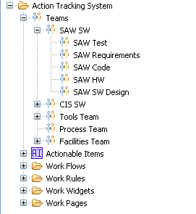
ATS Configuration – Team Definition
Artifact in OSEE represents a team that is responsible for performing work
Configured with users that perform roles
  Team Lead – Endorses Team Workflow, Assigns Work
  Team Member – Performs Work on Team
  Privileged Member – Able to override assignee and edit any field in Team Workflow
Related to Actionable Items that they are responsible for
Related to Workflow Configuration that defines how this team does it’s work

Slide 4
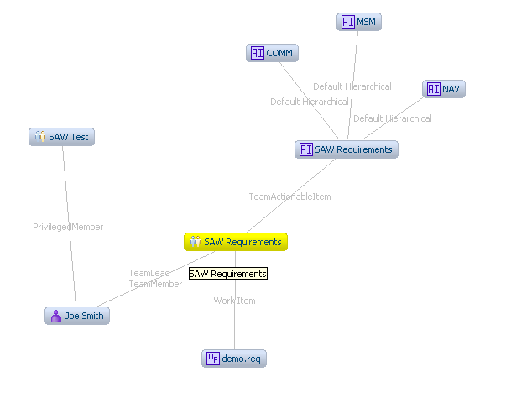
ATS Configuration – Team Definition

Slide 5
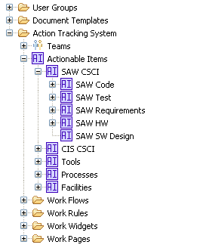
ATS Configuration – Actionable Item
Artifact in OSEE represents a real or conceptual object that the user would write an Action against
Active Flag enables items to be retired
Related to Team Definitions that are responsible for them

Slide 6
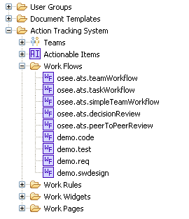
ATS Configuration – Work Flows
Artifact in OSEE represents a how a team performs it’s work
Represented by a state machine with Work Pages being states
Related to Team Definitions uses them
Related to Work Pages and Work Rules that apply

Slide 7
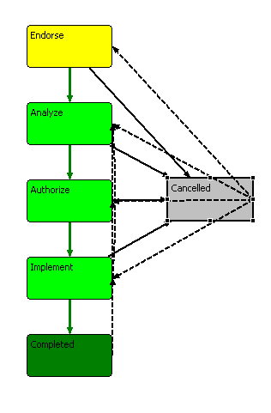
ATS Configuration – Work Flows

Slide 8
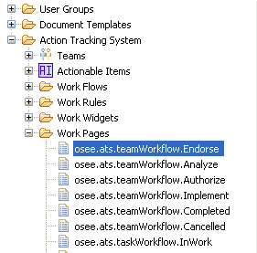
ATS Configuration – Work Pages
Artifact in OSEE that represents a a state in a Work Flow
Represented by a state machine with Work Pages being states
Related to Work Flow they belong to
Related to Work Rules and Work Widgets

Slide 9
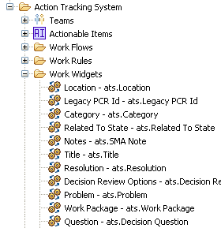
ATS Configuration – Work Widgets
Artifact in OSEE that represents a a single Widget to display for a Work Page
Contains some formatting information
Includes information relating widget contents to storage attribute
Related to Work Page they belong to

Slide 10
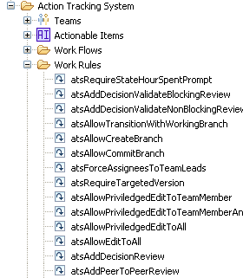
ATS Configuration – Work Rules
Artifact in OSEE that represents a rule to be applied to Work Flow or Work Page
Backed by code that provides the functionality described
ATS provides built in rules for use by work flows
New rules can provided through extension points

Slide 11
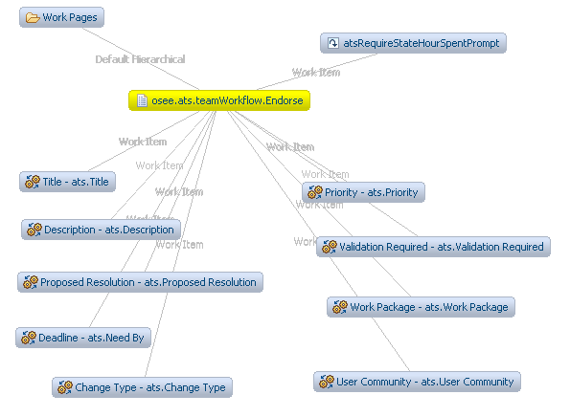
ATS Configuration – Work Pages, Widgets, Rules

Slide 12
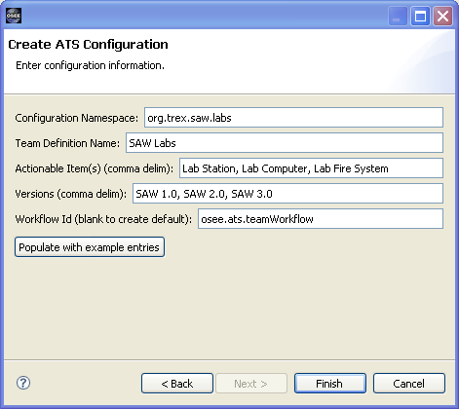
T. Rex Company – Let’s track a new SAW Lab
File -> New -> Other -> OSEE ATS -> Create ATS Configuration
Select “Populate with example entries” button

Slide 13
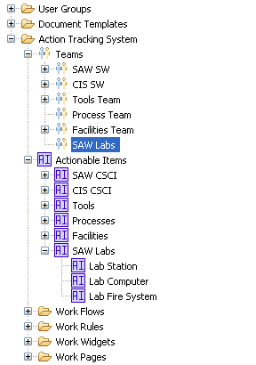
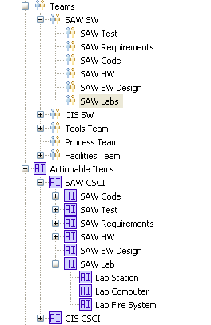
T. Rex – Re-Organize Team Defs and Actionable Items
In Artifact Explorer:
Move New “SAW Labs” Team Definition under “SAW SW” Team
Move New “SAW Lab” Actionable Items under “SAW CSCI” Item
becomes
Notes:
TODO – update left capture image

Slide 14
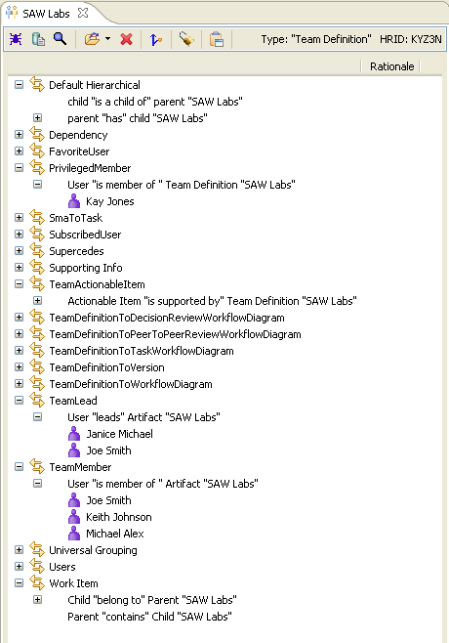
T. Rex – Configure Team Leads and Members
Search Pulldown – Artifact Search – Artifact Type – User –
Add Filter - Search
From Search Results:
  Drag “Janice Michael” to Team Lead
  Drag “Keith Johnson” and “Michael Alex”” to Team Member
  Drag “Kay Jones” to Privileged Member
  Save

Slide 15
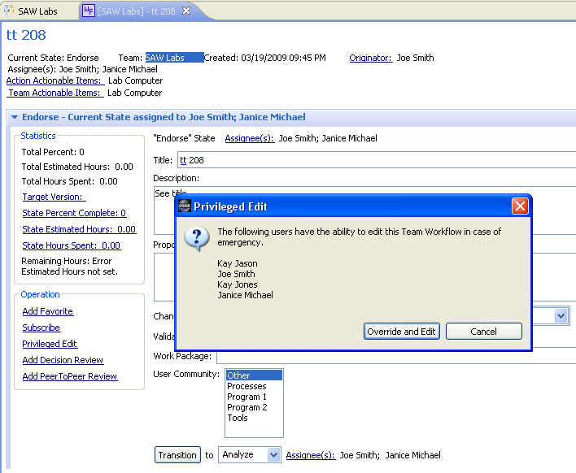
T. Rex – Let’s Try It…
ATS Navigator – New Action – Lab Computer Actionable Item
Complete Action Wizard
Notice:
  Endorse State assigned to both leads “Janice” and “Joe”
  Privileged Edit allows “Kay Jones” to override

Slide 16
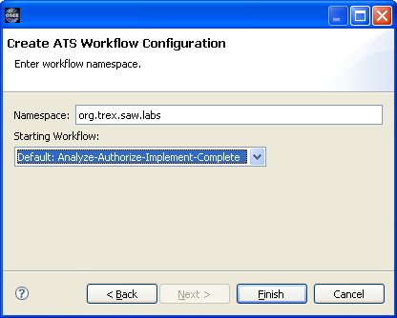
T. Rex – Labs team wants different workflow…
File -> New -> Other -> OSEE ATS -> Create ATS Workflow

Slide 17
T. Rex – Set new Labs team workflow configuration
Double-click “SAW Lab” Team Definition
Switch to Relations tab
Expand “Work Item”
Right-click – “Delete Relation” on item “osee.ats.teamWorkflow”
From Artifact Explorer, drag “org.trex.saw.labs” workflow to Work Item – Child
Save

Slide 18
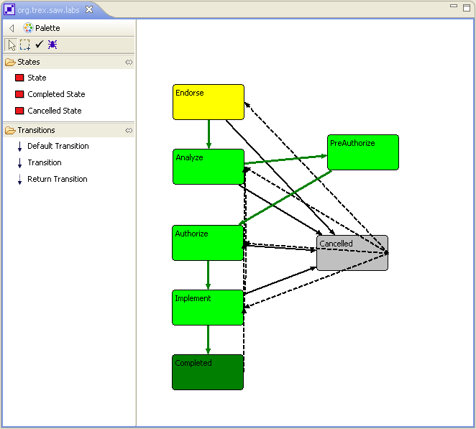
T. Rex – Add a PreAuthorize state…
Click “State” and click in editor area
Add “Default Transition” from Analyze to PreAuthorize and from PreAuthorize to Authorize
In Properties view, change state name to PreAuthorize (Note: id will be updated automatically)
Save

Slide 19
T. Rex – Let’s Try It with the new PreAuthorize state
ATS Navigator – New Action – Lab Computer Actionable Item
Complete Action Wizard
Transition through to “Implement” state and note that new PreAuthorize state exists

